Slide 1
Net731
Prac
Ryan Williams
20241177

Slide 2
Project overview
We created a secure azure cloud envirmoent with networking monitoring and with cost management

Slide 3
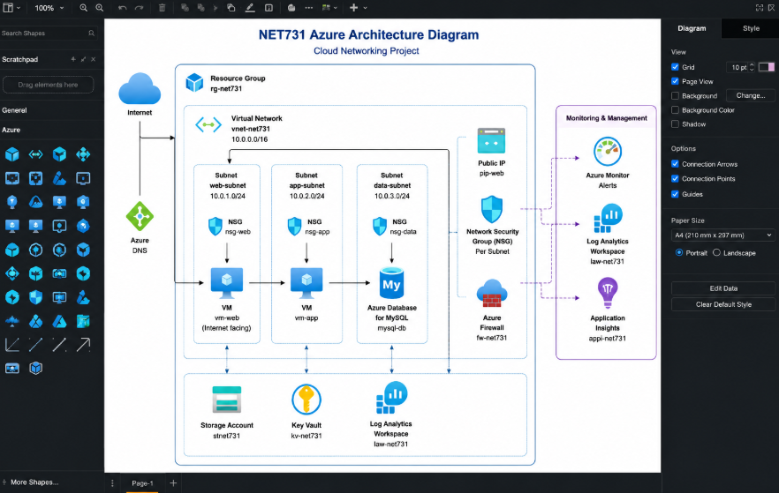
diagram

Slide 4
Key technical terms
i used b1s vm to reduce the cost of the cm running
Used nsg for security
And we configured a azure monitor

Slide 5
Security and monitoring
Nsg rules is a firewall which filters in and outbound traffic for your resources
Rbac is a authorization system which gives you presices access manemenet to the cloud
Log analytics is a tool used to edit run and viulse log queries
Alerts lets you know when importanted conditions are found in your data

Slide 6
Cost management
Budget alerts is a automatic notification that checks cloud spending
Vm resizing updates the vm to better the performance or to scale down the cost
Monthly projected spend helps you track and control your spend within your resources

Slide 7
Challenges and soloutions
Vm issues connection timed out I had to create a new inbound rule
Budget concern idling within the vm I just configuring azure to automatically shutdown

Slide 8
Lesseson learned
Azure cost management azure is very flexible
Cloud security if configured correctly its very safe

Slide 9
Conclusion
What we achived we creared a azure account and subscription configured ad created vns created nsgs created azure storage accounts configured azur monitor created and configured azure vms configured azure budgets and alerts

